Slide 1
Engineering Economics in Software Architecture
REMINDER: all this is fair game for exams!
Stephen Riley, MSE ‘07

Slide 2
About me
Engineering leader (manager of managers, architect)
Languages: C#, C, C++, Perl, Python, Ruby, Java, Elixir, JavaScript, TypeScript, F#
Industries: Desktop publishing, e-commerce, warehouse automation, web security, telephony, fin-tech, physical security, NLP, entertainment, military…

Slide 3
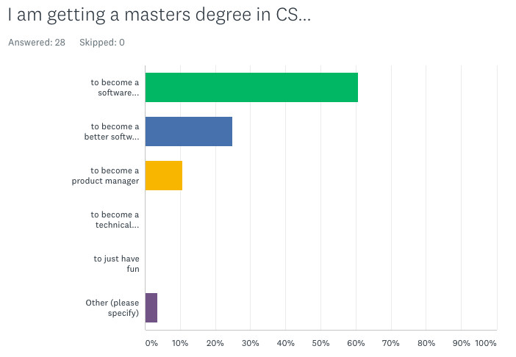
About you

Slide 4
Agenda
Ridiculously inadequate intro to Engineering Economics
Applying Eng’g Econ to software architecture
Q & A (about anything)

Slide 5
Engineering Econ
An entirely inadequate introduction

Slide 6
THIS IS HOW ALL SOFTWARE DESIGN / ARCHITECTURE DECISIONS SHOULD BE MADE.

Slide 7
What is Eng’g Econ?
A rational and deliberate way to expend resources most efficiently toward the benefit of the organization.
A cost-based way to make engineering decisions.

Slide 8
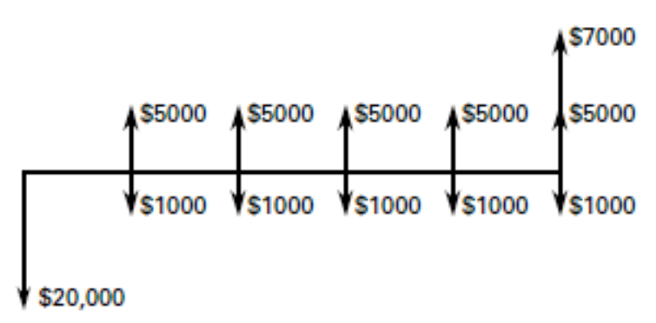
Cash Flow Diagrams
A brute-force way of showing the economics of a situation.
(sometimes brute-force is best.)

Slide 9
Fundamentals of Eng’g Econ
Time-value of money
Present value of future money
Future value of present money
Interest rates/inflation
Comparison of alternatives
Should I do A or B? (Cost-benefit and ROI)
A (sort-of) way to measure opportunity cost

Slide 10
Time-value of money
P/F
F/P
Interest rates
Annuities (P/A)
Not going to get into it

Slide 11
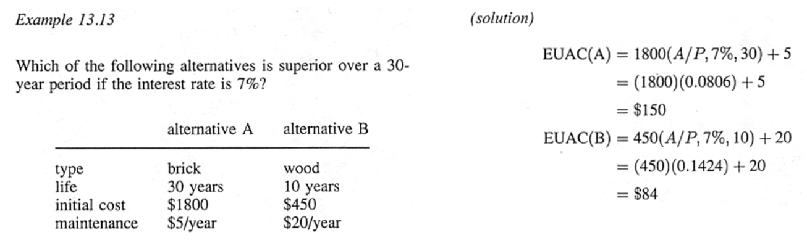
Comparison of Alternatives
Very simple:
WHAT COSTS LESS?
Remember the planning horizon
Notes:
Sometimes the alternatives have very different timelines, planning horizons, etc. You have to rationalize them to make a fair comparison.

Slide 12
The Do-Nothing Alternative
Which is cheaper?
Alternative A
Alternative B
Doing nothing at all
How much does it cost to leave well enough alone?
Always always always always always evaluate this!
Notes:
Sometimes throwing bodies at the problem really is the most economic!

Slide 13
Opportunity cost
What you’re not getting by doing something
What are you losing the opportunity to do?
Example: going to grad school
Obvious costs: tuition, books
Benefits: Better job prospects, bragging rights
Non-obvious costs: Child care? Social life?

Slide 14
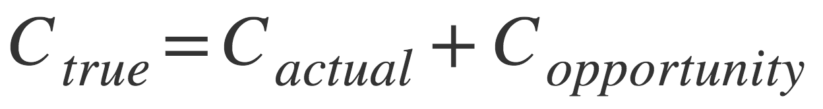
Opportunity cost
The true cost of doing something is always actual + opportunity

Slide 15
Measuring opportunity cost
How do you measure the future?!
Put a dollar figure on all initiatives
It’s hard, but you can estimate it
Use opportunity cost as a sniff test
Three kinds of projects:
Sales initiatives (revenue)
Efficiency initiatives (cost savings)
Research (potential revenue or savings)
Notes:
For all initiatives, figure out what the dollar value is:
Product for sale? It’s the sales estimate
Efficiency initiative in-house? It’s the salary of the people’s time you’re saving
That way, when you’re measuring opportunity cost, you can see what you’re NOT earning/saving

Slide 16
Questions?
(don’t worry, we’ll see this again)

Slide 17
Eng’g Econ applied to software…

Slide 19
“Technology starts and ends with people.”
So let’s look at the start…

Slide 20
Questions software architects often ask
What tech should I use?
How much will my stack cost?

Slide 21
Questions software architects rarely ask (but should!)
Is this tech too new? Too old?
Do I have the right people?
Can I hire the people I need?
Is there marketing buzz to jump in on?
How long will this system be alive?
Does anyone really know the requirements?
Can we get a tax break?
How much will this actually cost?!

Slide 22
In other words…
Management
HR
CFO
Marketing
Sales
Local economy
…these people all get consideration!

Slide 23


Slide 24
Questions software architects rarely ask (but should!)
Is this tech too new? Too old?
Do I have the right people?
Can I hire the people I need?
Is there marketing buzz to jump in on?
How long will this system be alive?
Does anyone really know the requirements?
Can we get a tax break?
How much will this actually cost?!

Slide 25
Is the tech too new? Too old?
Old
Pros: proven tech, lots of docs
Cons: availability, cost, and quality of engineers
New
Pros: The New Hotness™! Lots of excited engineers
Cons: not proven in market, lots of bugs, quality of engineers
Local market, HR

Slide 26
Do I have the right people?
Be honest
Consider experience and potential
Tradeoffs
Team up for The New Hotness™?
Use known techniques?
Can you hire quickly enough?

Slide 27
Can I hire the people I need?
Short answer: NOT TODAY!
Planning considerations: at least…
30 days for a junior
60 for mid
90 for senior
??? for principal
15-20% of first year’s salary for recruiting
People don’t grow on trees. Don’t pretend they do.

Slide 28
Marketing buzz?
Your tech decisions can drive marketing!
Yes, it’s BS.
Yes, it matters!
Eg. Deep Learning, Big Data, Microservice Architecture, Cloud, SOA…
Marketing buzz ==
Better hiring
Enterprise sales lift
Better hiring
More investment

Slide 29
How long will this live?
(AKA “planning horizon”)
Might be longer than you think… Be realistic!
75-80% of a project’s cost comes after 1.0!
Depreciation

Slide 30
Who knows the requirements?
#1 killer of projects: bad requirements
This might be your first job!
Don’t commit to budget until you are confident of this!
Time-box becoming an “expert”

Slide 31
Tax breaks?
Building a new project counts as a “capital expenditure” (CAPEX)
Maintenance counts as “operational expenditure” (OPEX)
CAPEX is depreciable
CAPEX effectively reduces OPEX on the balance sheet (GAAP)
Notes:
R&D as a discriminator: you cannot capitalize Research, but you can Development
Interesting as it applies to ML

Slide 32
So how much does it actually cost?
It ain’t just tech!
In fact, when you lay it all out, it’s mostly not tech!
(People and business issues will sink your project’s chances more than tech issues)

Slide 33
putting it all together

Slide 34
Cost comparisons
Case study: rebuild CI system or do feature work? (10 devs)
CI
Will save 20% dev time
Requires an Ops head to maintain
$50K/yr licensing
Feature
$100K/mo revenue, ramp up over a year
Assume 20% YoY growth

Slide 35
A bit about budgets
Usually by month
As much about time as money
Cheat sheet:
Dev equipment per person
Infrastructure cost (eg. Cloud services)
Cost per person (loaded vs. salary)
Recruiting costs
Ramp-up time (project and people)
Time per week per person on project (80% max!)
Management functions (“Rule of 5”)
CAPEX and OPEX separately
Customer support load
IT load (if any)
COGS (ask the CFO)
G&A (ask the CFO)

Slide 36
References
Return on Software, Steve Tockey
en.wikipedia.org/wiki/Engineering_economics
en.wikipedia.org/wiki/Industrial_engineering
www.valpo.edu/student/asme/FE%20Slides/EngEconSlides.pdf

Slide 37
Next time…
Non-Functional Requirements
(aka “the –ilities”)

Slide 38

E. Coli storage

Slide 39
“Implications for Management”
Keep tasks small.
Plan for uncertainty by leaving adequate margins.
Start critical work early since almost half the time it will take longer than expected, sometimes much longer.
Don't be fooled by short-term progress.
Provide a quiet work place so that programmers can focus.
Emphasize the importance of design to control the complexity and size of solutions.
Encourage frequent peer review.
Automate routine tasks such as regression test and deployment.
Develop talent with training, such as for design, review, and test.
Since quality can be taught and benefits apply to the total lifecycle cost, emphasize quality rather than speed.
“Programmer Moneyball: Challenging the Myth of Individual Programmer Productivity” – CMU SEI

